Slide 1
Early life physiological and energetic responses of Atlantic silversides (Menidia menidia) to ocean acidification, warming, and hypoxia
Teresa G. Schwemmer

Slide 2


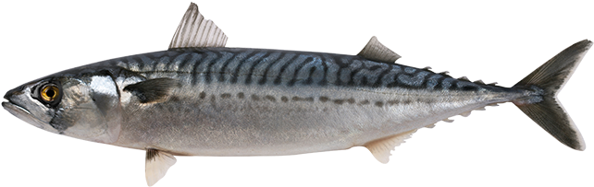
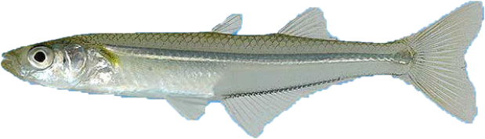
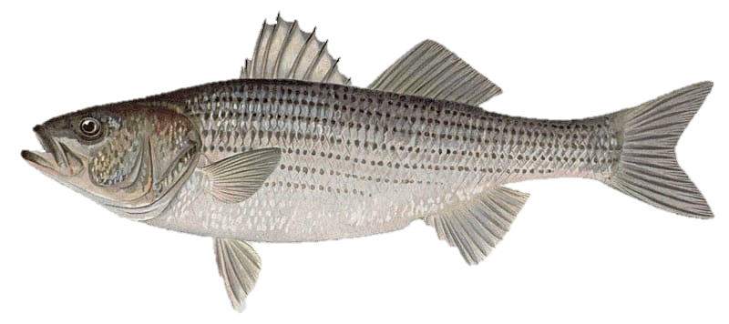
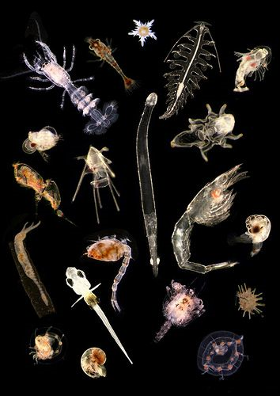
Atlantic silversides Menidia menidia
Notes:
-Atlantic silversides are a small, but very abundant fish that is found all along the east coast of North America
-They eat plankton, so they are an important way for energy to make its way up the food web
-Because of their ecological importance it is important to understand how they respond to changing environmental conditions
And to figure out what those changes MEAN by looking at the underlying mechanisms

Slide 3
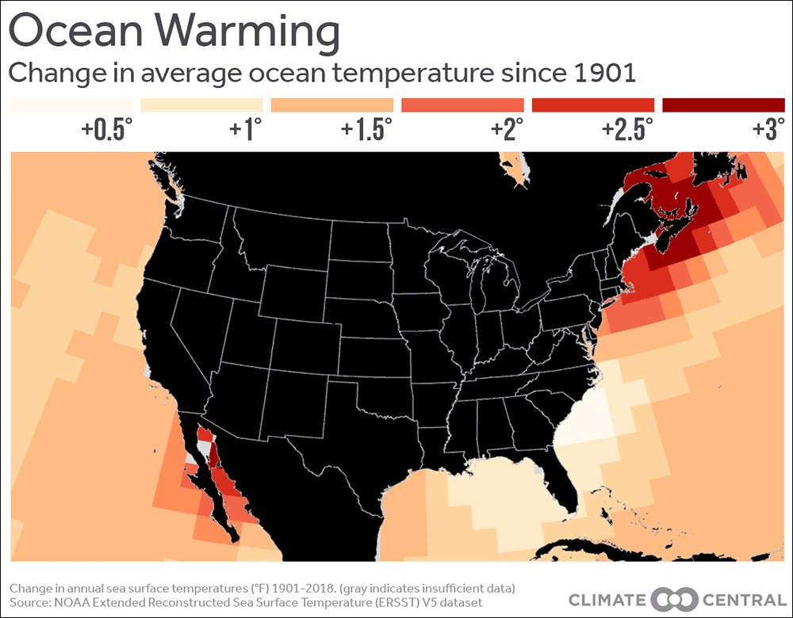
The Perfect Storm: Multiple Intensifying Stressors in Estuaries
OCEAN ACIDIFICATION
WARMING
HYPOXIA
Source: Climate Central
Notes:
-Silversides live in estuaries and coastal waters along the east coast, and the ones I did my research on are from bays and estuaries connected to Long Island Sound
-This area is experiencing a combination of gradual global changes and more intense, fluctuating conditions
-At the same time, the waters off the Northeast US are some of the fastest warming waters worldwide
-Long island is here – not as bad as Gulf of Maine and north but still has warmed by about 2 or more degrees FAHRENHEIT

Slide 4
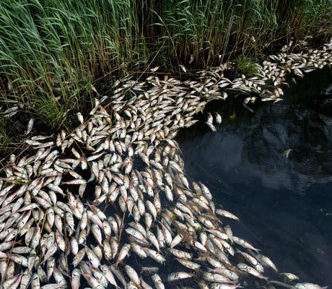
The Perfect Storm: Multiple Intensifying Stressors in Estuaries
OCEAN ACIDIFICATION
WARMING
HYPOXIA
Source: NY Times
Notes:
-Warmer water holds less dissolved oxygen
-This is contributing to widespread ocean deoxygenation worldwide, and hypoxic ‘dead’ zones that cause fish kills like this are becoming more common

Slide 5
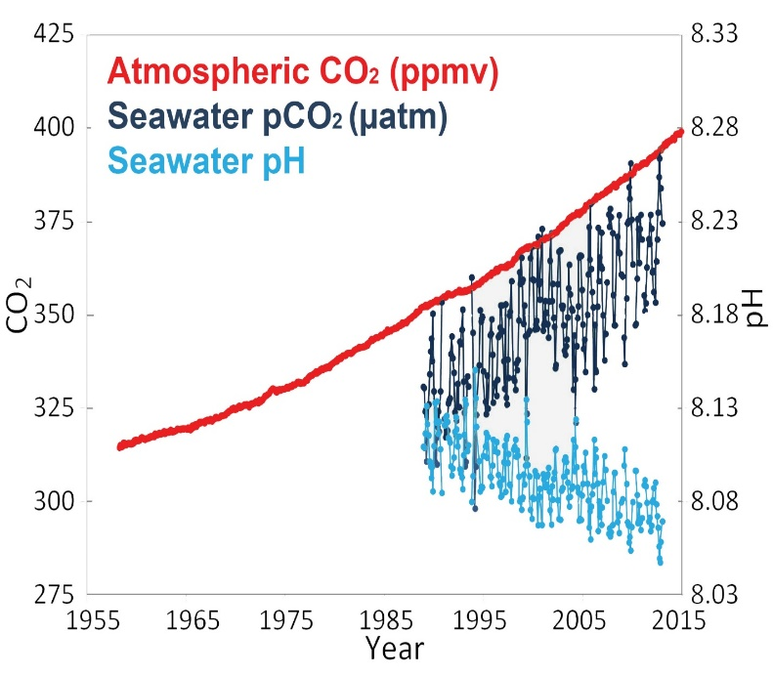
The Perfect Storm: Multiple Intensifying Stressors in Estuaries
OCEAN ACIDIFICATION
WARMING
HYPOXIA
Source: NOAA
Notes:
-Ocean acidification is gradually decreasing the pH in the ocean worldwide. As CO2 from GHG emissions dissolves into the water, CO2 goes up and pH goes down.

Slide 6
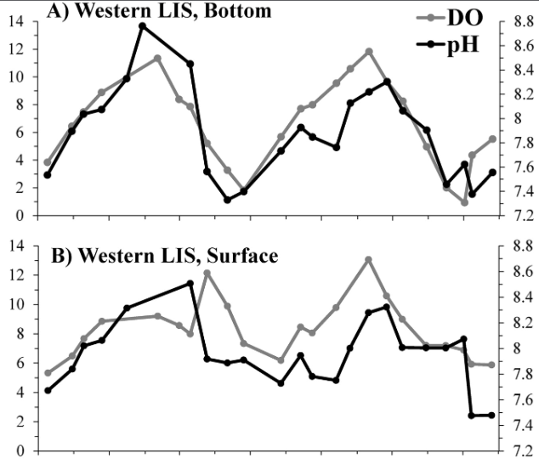

Conditions are even more severe in estuaries, where young silversides live
Oxygen and pH fluctuate together
Contributing factors:
Community respiration
Particulate organic matter and decomposition
Stratification
*Fully oxygenated is ~8 mg/L
*Open ocean pH is ~8.1
Dissolved oxygen (mg L⁻¹)
pH
Wallace et al., 2014
Notes:
-In estuaries, which silverside offspring use as a nursery, these changes are happening on top of highly fluctuating and extreme conditions
-Warming causes stratification that can trap hypoxic waters at the bottom and prevent surface oxygen from reaching the bottom
-Coastal waters have a lot of respiration going on – both from densely populated marine life and microbial respiration from decomposition of organic matter
-The closed-in shapes of some estuaries can delay mixing with outside seawater to help dissipate the acidified, hypoxic water that forms
-As a result, pH and oxygen tend to covary – as shown here for western Long Island sound
-Summer is when both of these stressors are at their worst, especially in bottom waters (DO is below 2 mg/L and pH is almost a whole unit below that of the open ocean, which is about 10x as acidic because it is on a log scale)
-Silversides are already experiencing conditions more severe than those predicted for global change, and they experience multiple stressors at once
-To understand their tolerance realistically, we need to study the effects of multiple stressors at the same time

Slide 7
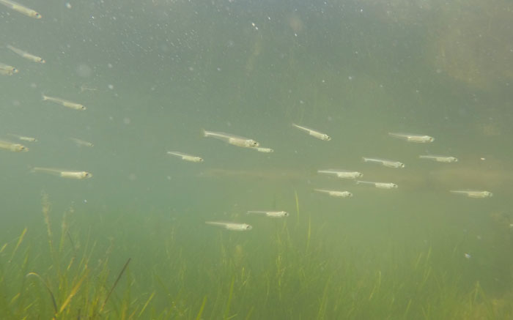
Early life stages least mobile
Nursery habitats experience great fluctuations
How does early life exposure to multiple stressors affect Atlantic silversides?
Photo: Brian Leuchtenburg, FishersIsland.net
Notes:
-Silversides are already experiencing conditions more severe than those predicted for global change
-The early life stages, which are thought to be more sensitive to stressors, experience multiple stressors at once in their habitat
-This means to understand their tolerance realistically, we need to study the effects of multiple stressors at the same time

Slide 8
Interacting effects
Control S1 S2 S1 + S2
Control S1 S2 S1 + S2

Slide 9
Interacting effects
Control S1 S2 S1 + S2
Control S1 S2 S1 + S2
Notes:
-You can also have interactions where a treatment by itself has no effect but when you add an additional stressor, it starts to have an effect

Slide 10
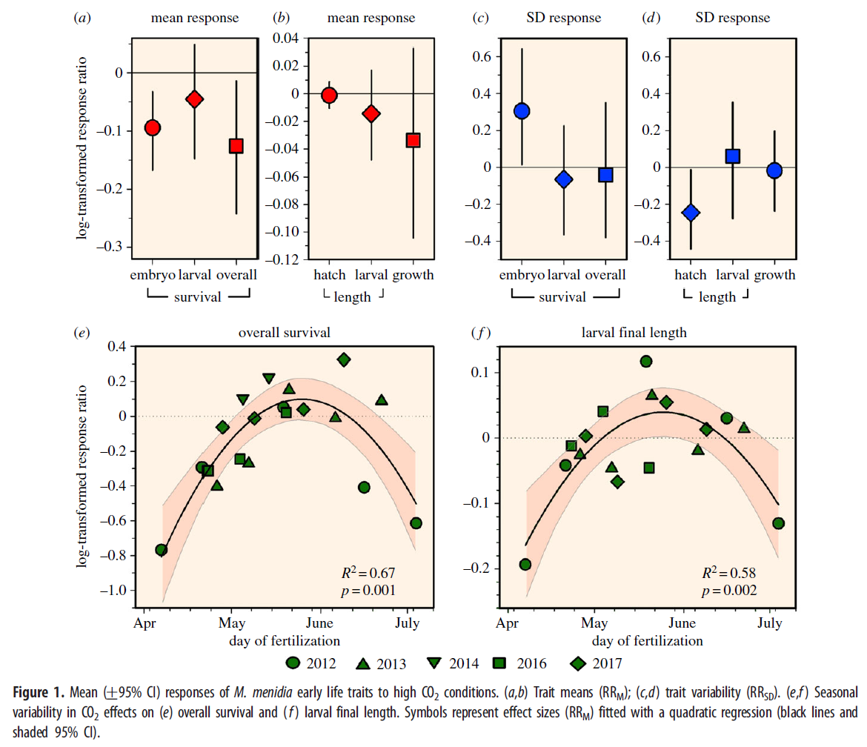
Variable responses to acidification have been observed
Survival
Growth
No effect near line
Negative effects sometimes
Baumann et al. (2018), Biology Letters

Slide 11
Variable responses to acidification have been observed
Survival
Growth
What are the underlying physiological mechanisms?
No effect near line
Negative effects sometimes
Baumann et al. (2018), Biology Letters
Notes:
-What still hadn’t been looked at, for silversides as well as many other species, is what the underlying mechanisms are.
-How are they compensating for low pH and other co-occurring stressors?
-What physiological mechanisms help them tolerate it, and what tradeoffs might be occurring that are harmful to things like growth, recruitment, and reproduction?
-This can help us understand how populations and ecosystems will be affected as well

Slide 12
Objectives
Chapter 1: Measure metabolic effects of CO₂, temperature, and oxygen treatments
Chapter 2: Does acidification alter metabolic response to progressive, acute hypoxia?
Chapter 3: Identify mechanism of pH regulation in early life stages across CO₂ and temperature levels
Chapter 4: Attribute early life hypoxia responses to energetic mechanisms using a Dynamic Energy Budget

Slide 13
Objectives
Chapter 1: Measure metabolic effects of CO₂, temperature, and oxygen treatments
Chapter 2: Does acidification alter metabolic response to progressive, acute hypoxia?
Chapter 3: Identify mechanism of pH regulation in early life stages across CO₂ and temperature levels
Chapter 4: Attribute early life hypoxia responses to energetic mechanisms using a Dynamic Energy Budget

Slide 14
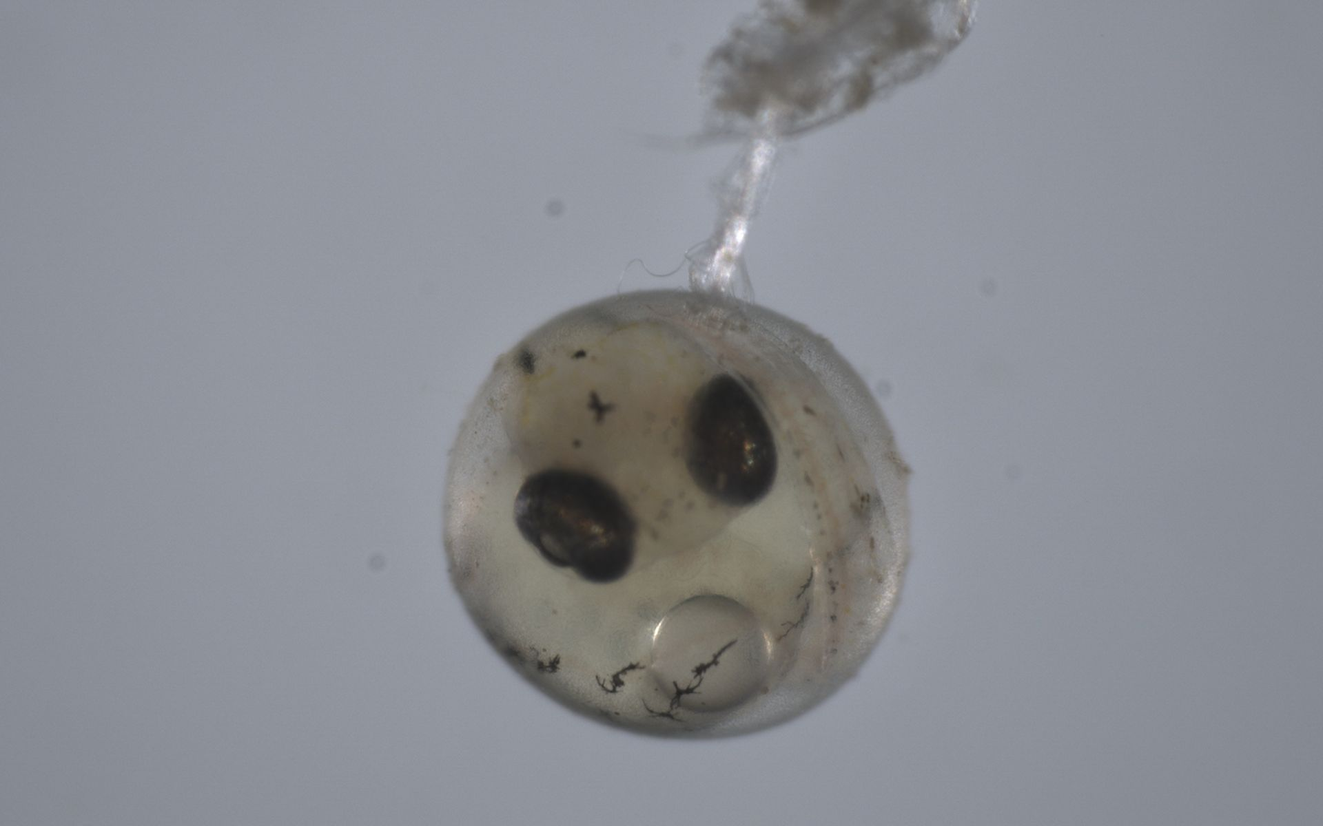
Chapter 1: Metabolic rates of offspring exposed to CO₂, temperature, and oxygen treatments
Experimental design
Two types of experiments conducted by Baumann Lab at UConn:
Temperature x CO₂
Oxygen x CO₂
Catch wild adults and spawn in lab
Start treatments right after fertilization
M. medina embryo

Slide 15
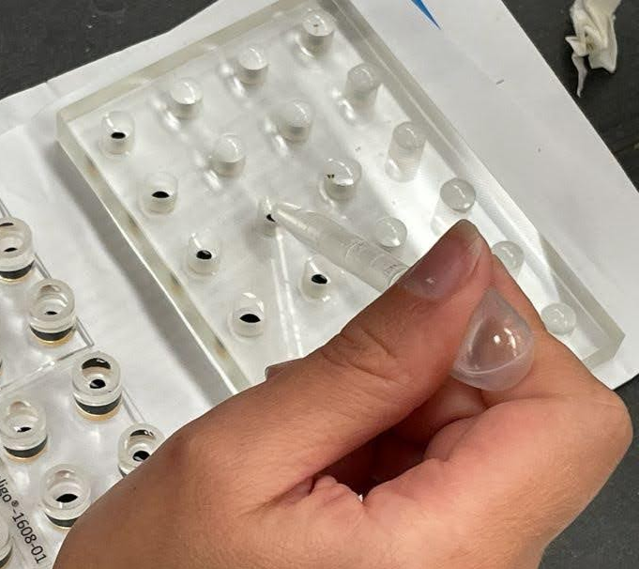
Chapter 1: Metabolic rates of offspring exposed to CO₂, temperature, and oxygen treatments
Experimental design:
Experimental treatments:
Temperature: 17, 20, 24, 28°C
CO₂: 400, 2200, 4200 µatm
Oxygen: 8, 4, 3, 2.5 mg/L
Sample:
Embryos
Newly hatched larvae
Respirometry wells

Slide 16
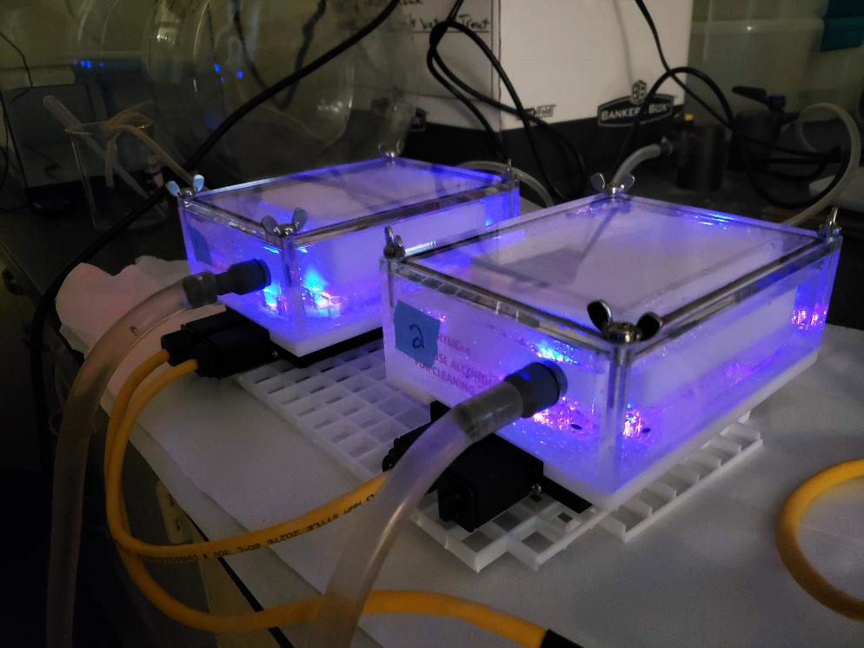
Chapter 1: Metabolic rates of offspring exposed to CO₂, temperature, and oxygen treatments
Hypotheses:
Metabolism increases with warmer temperatures
Metabolism increases with acidification
Metabolism decreases with low oxygen
Optical oxygen measurement

Slide 17
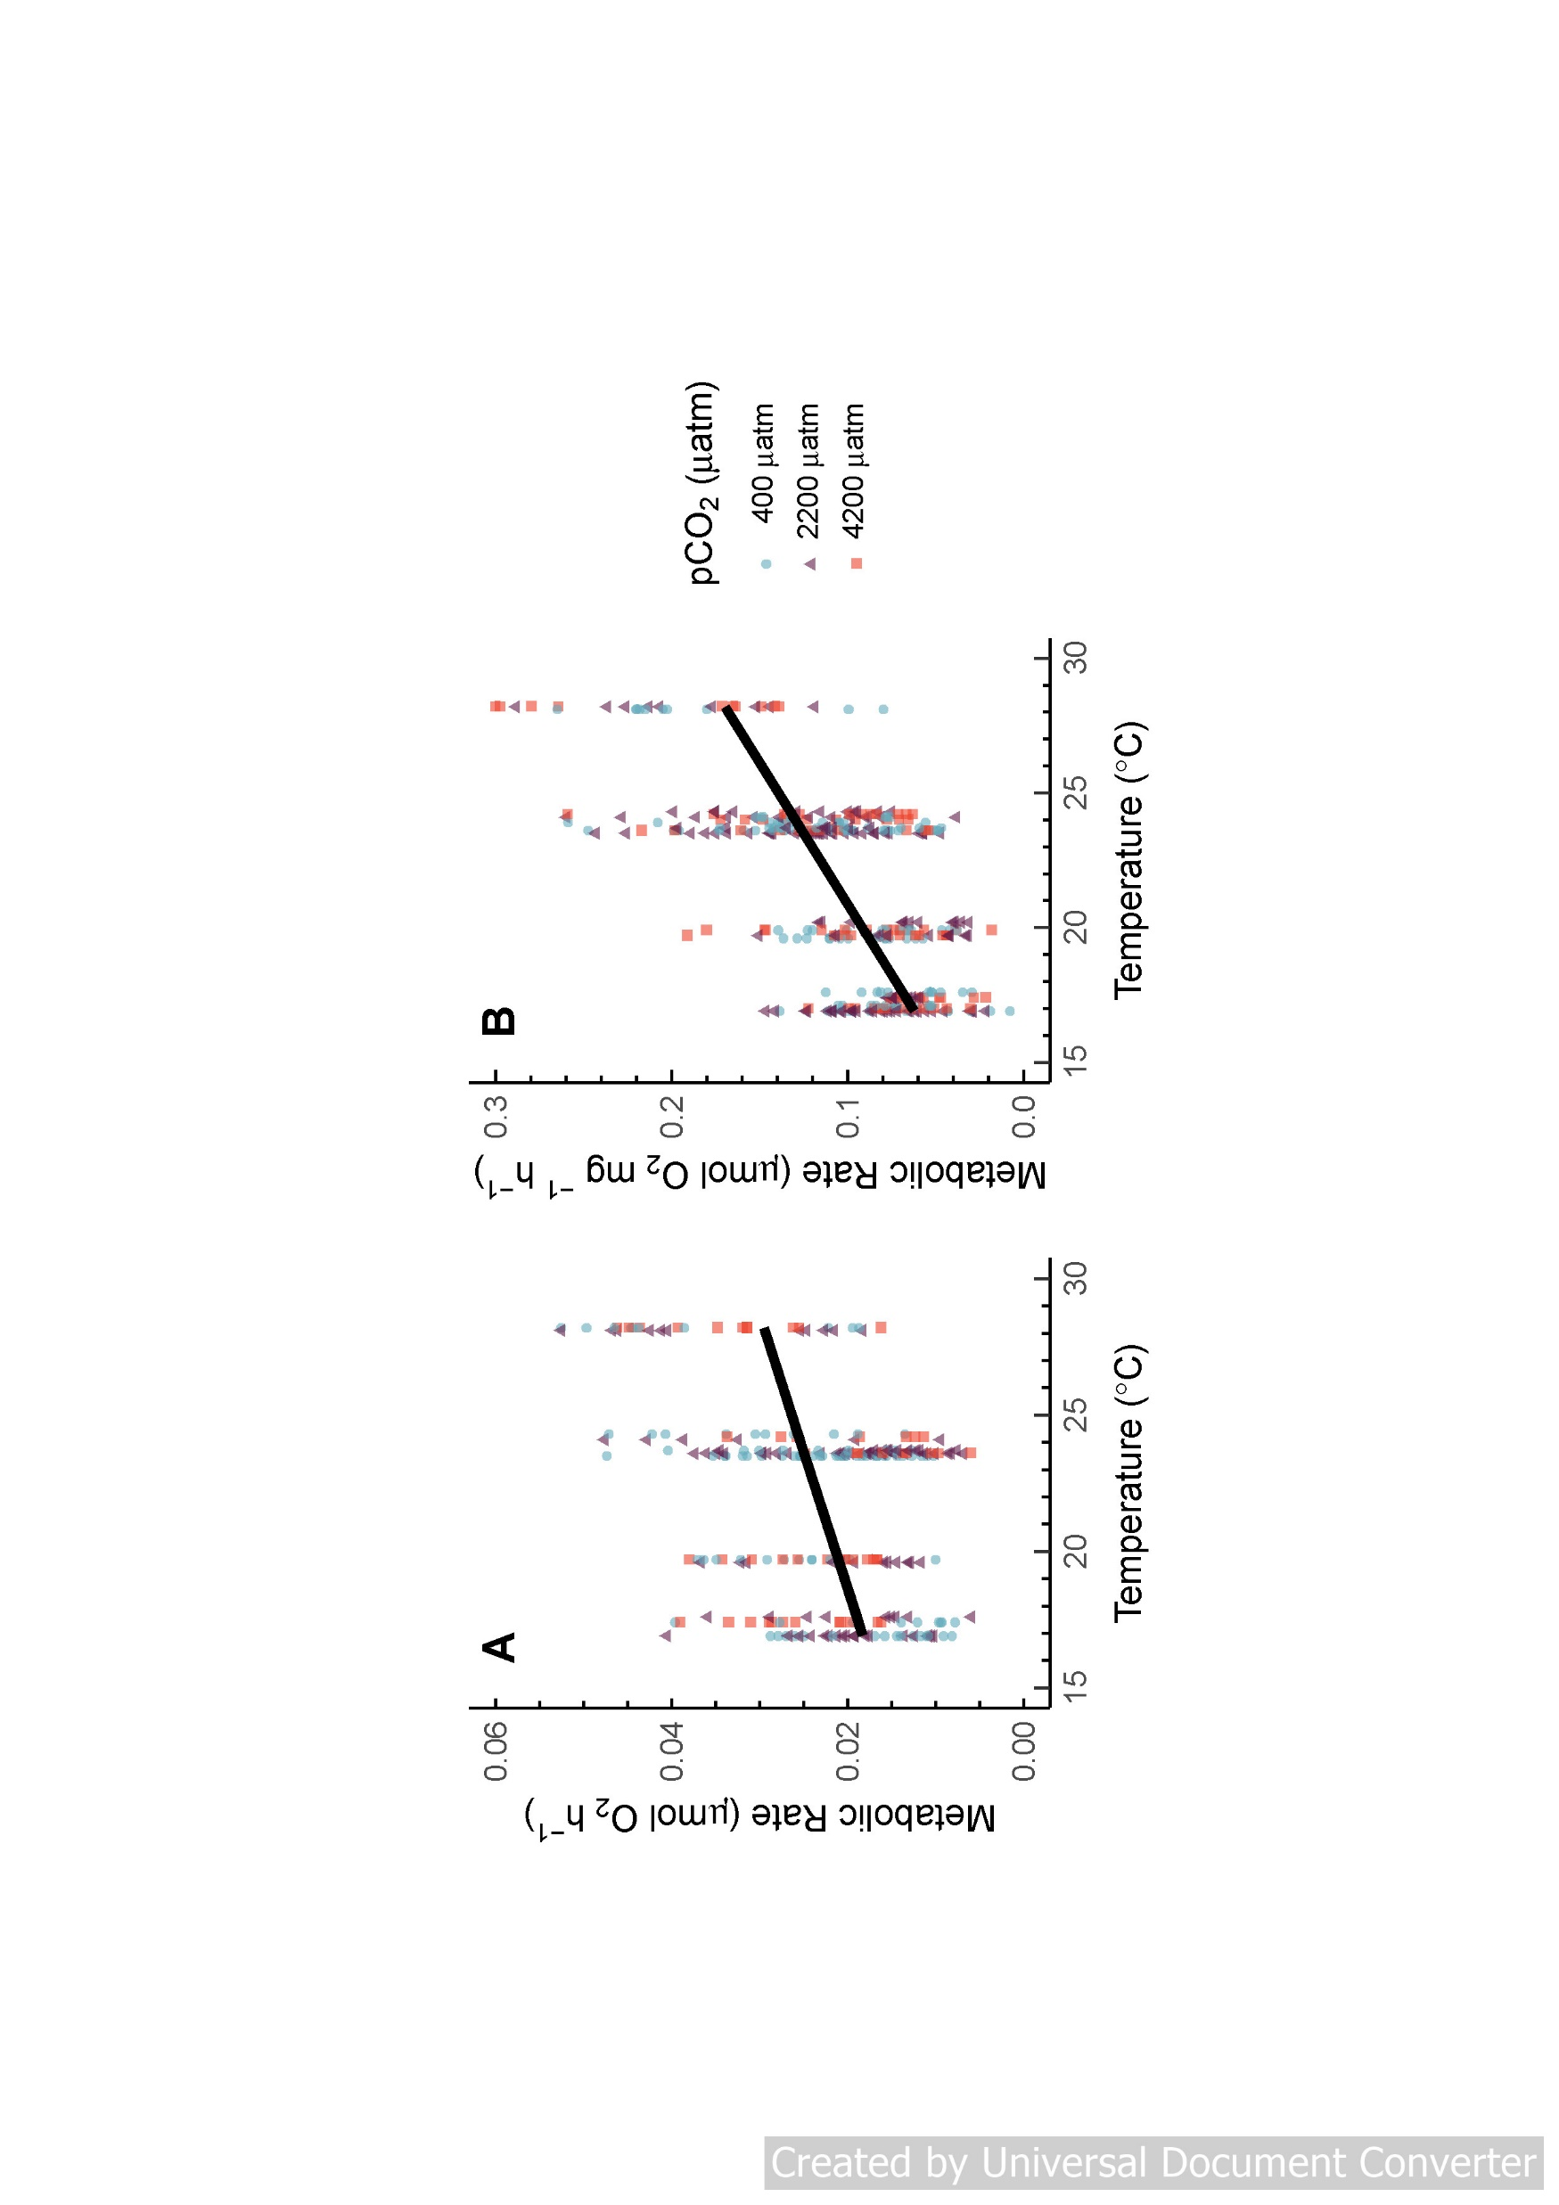
Chapter 1 Results: Temperature × CO₂
Embryos
Larvae
Only temperature affects metabolism
Schwemmer et al. (2020), J. Exp. Biol.
Notes:
-Analyzed four experiments combined with linear regression, to test for significant effect of CO2 or Temperature or their interaction
-Found no effect of CO2, but a significant increase in metabolism with temperature – as expected.

Slide 18
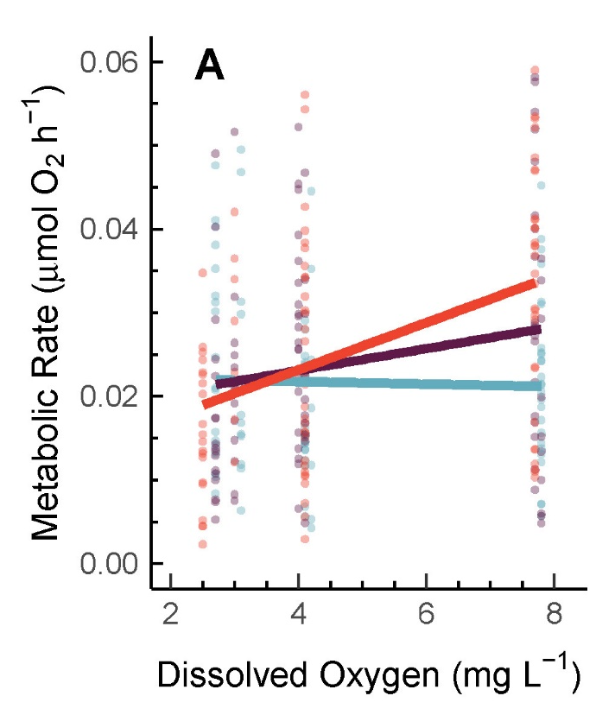
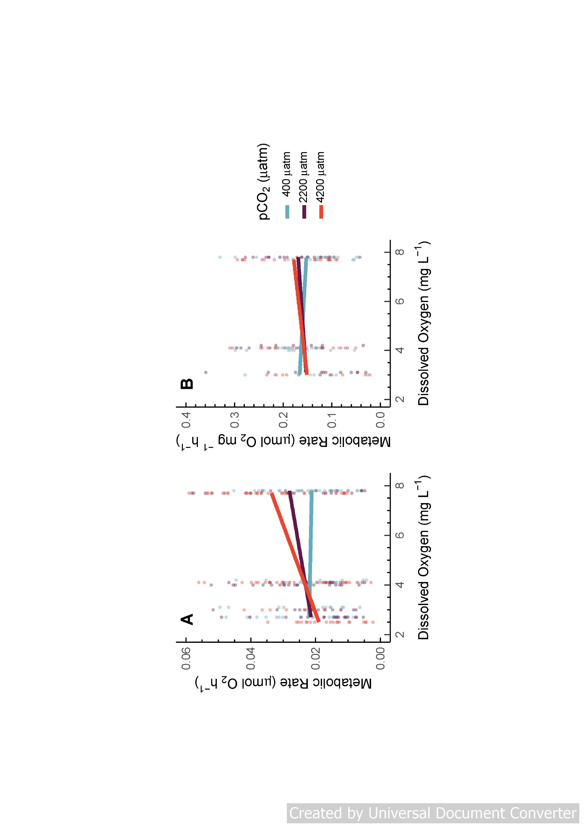
DO x CO₂: Acidification increases hypoxia sensitivity
Embryos
Ambient CO₂: unaffected by hypoxia
Medium and High CO₂: increasingly hypoxia-sensitive
High CO₂ metabolic rates ~30% greater than ambient CO₂ in normoxia
Schwemmer et al. (2020), J. Exp. Biol.
Notes:
-In the two experiments with oxygen and CO₂, we found a significant interaction between oxygen and CO₂
-

Slide 19
DO x CO₂: Acidification increases hypoxia sensitivity
Similar to this type of interaction:
Embryos
Control S1 S2 S1 + S2
Notes:
-Shows the importance of multistressor experiments, because at low CO2 there was no hypoxia effect but adding high CO2 brought about a hypoxia effect

Slide 20
Treatments affected embryos, but not larvae
Embryos
Larvae
Schwemmer et al. (2020), J. Exp. Biol.
Notes:
-However we did not see such an interaction for larvae
-Mention that we didn’t have larvae for the lowest DO level because none survived hatching.

Slide 21
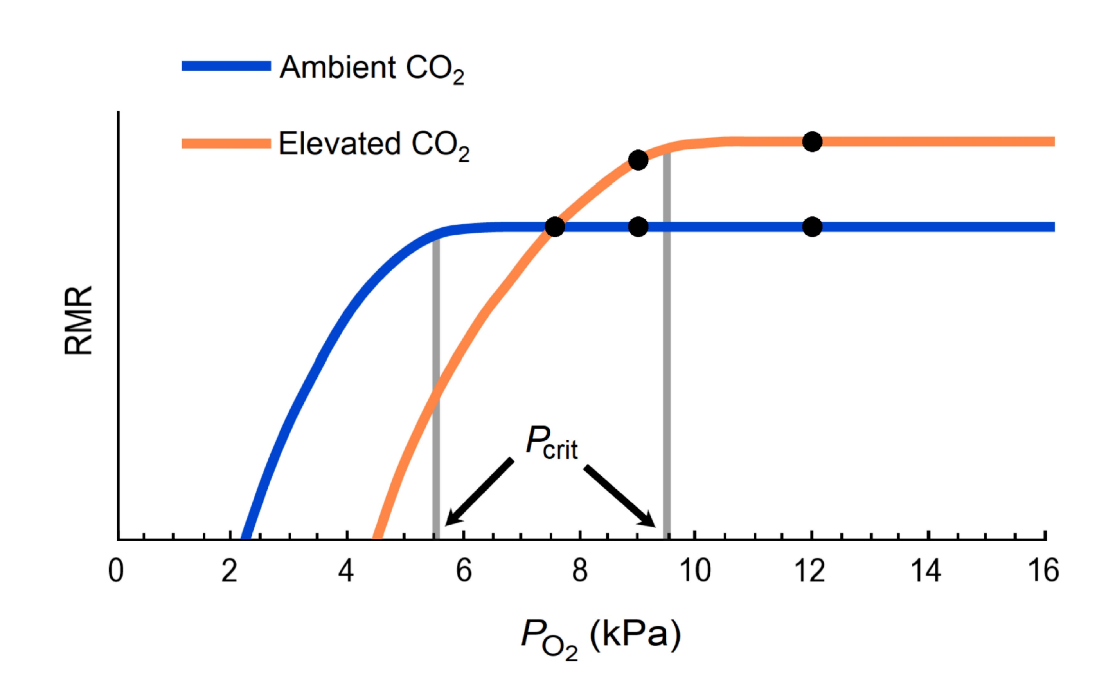
Digging deeper into the Oxygen x CO₂ interaction
Hypothesized Interaction Between CO₂ & Hypoxia
Original Experimental Oxygen Levels
Embryos are more sensitive
High CO₂ by itself has little effect on metabolism
Acidification may alter response to hypoxia
0 1 2 3 4 5
Dissolved Oxygen (mg/L)

Slide 22
Objectives
Chapter 1: Measure metabolic effects of CO₂, temperature, and oxygen treatments
Chapter 2: Does acidification alter metabolic response to progressive, acute hypoxia?
Chapter 3: Identify mechanism of pH regulation in early life stages across CO₂ and temperature levels
Chapter 4: Attribute early life hypoxia responses to energetic mechanisms using a Dynamic Energy Budget

Slide 23
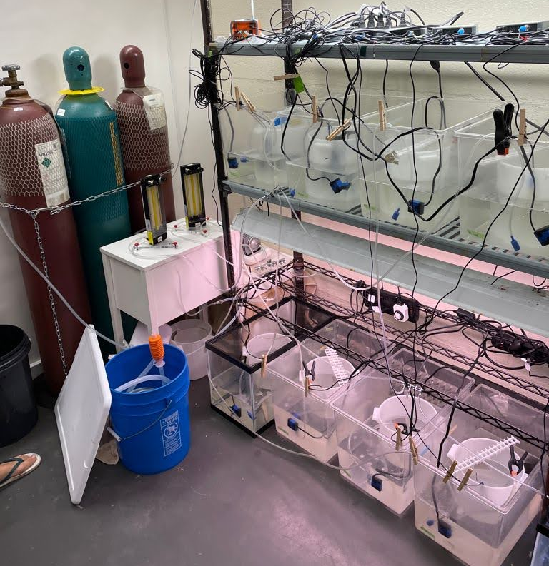
Chapter 2: Does acidification alter metabolic response to progressive, acute hypoxia?
Objective
Measure how CO₂ affects sensitivity to hypoxia.
Methods
Reared M. menidia at three CO₂ levels: 400, 2000, and 4000 µatm
Respirometry on:
Embryos
2 day-post-hatch larvae
5 day-post-hatch larvae
Let oxygen reach ~0 and calculate critical oxygen level (P_{crit})

Slide 24
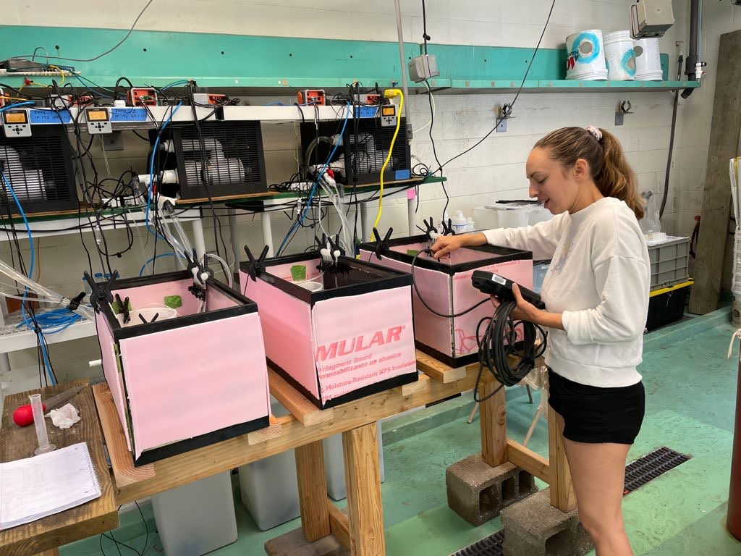
Chapter 2: Does acidification alter metabolic response to progressive, acute hypoxia?
Hypotheses
Metabolism increases with high CO_{2.}
High CO₂ increases P_{crit} (hypoxia sensitivity)
Notes:
-Once again testing the hypothesis that metabolism increases with CO₂ – repeating experiments is important because of past evidence that responses vary across experiments
-

Slide 25
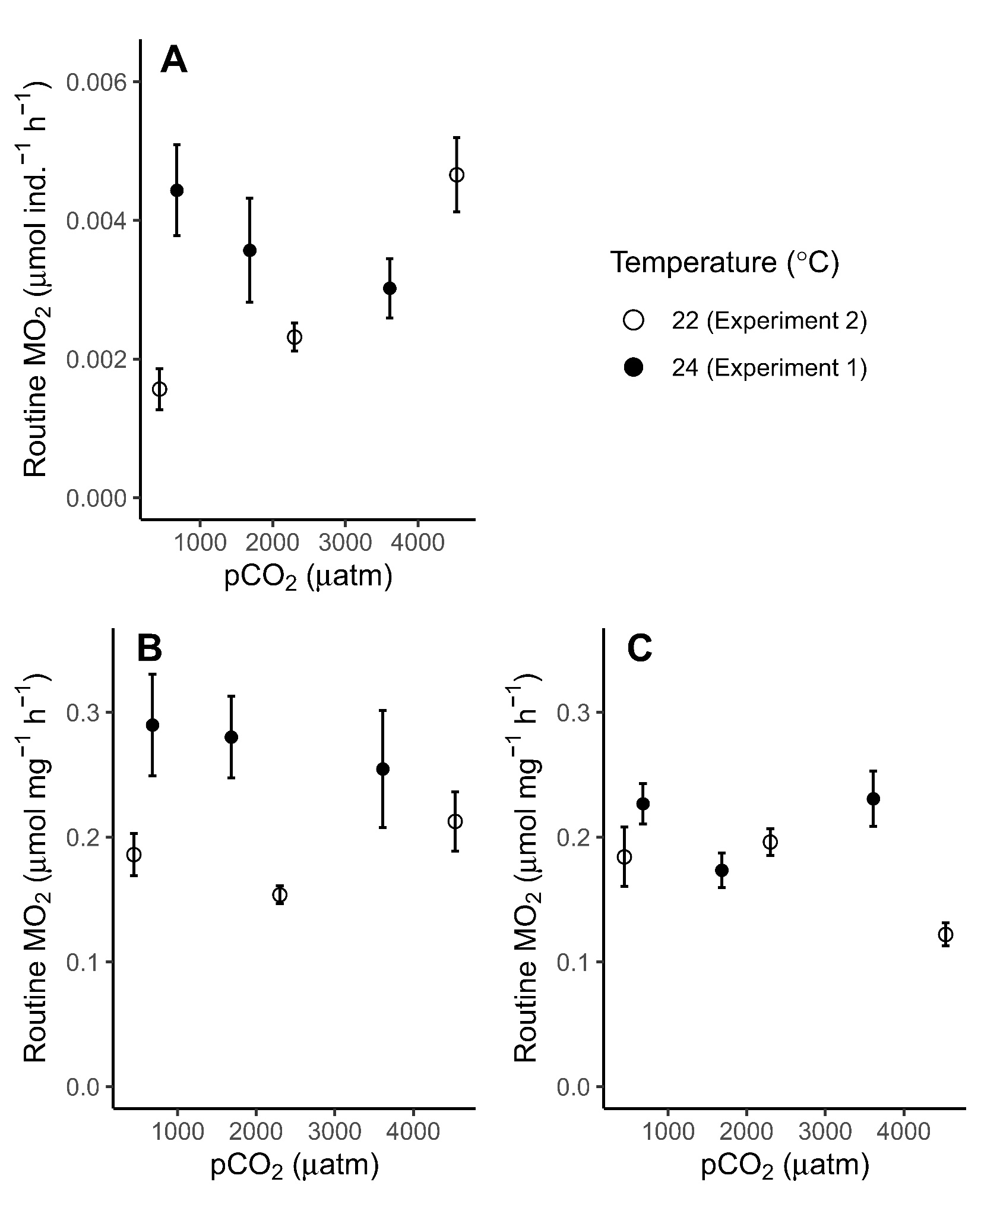
Chapter 2 Results: Metabolic Rates
Embryos
*
*
Opposite responses in embryos and larvae
Only affected at 22°C
Varying CO₂ treatments may have played a role
2 days-post-hatch
5 days-post-hatch
*
*
 | pH |  |  | pCO₂ (µatm)
 | Amb | Mod | High | Amb | Mod | High
Exp. 1 | 7.94 | 7.41 | 7.13 | 680 | 1683 | 3609
Exp. 2 | 8.08 | 7.39 | 7.09 | 442 | 2299 | 4531
*
= significantly different groups
Notes:
Explain letters
Only Exp 2 (22C) were affected – maybe because the high CO2 level is higher in that experiment, maybe a threshold between 3600 and 4200
The method used to acidify the treatments in
pH
pCO₂ (µatm)
Temperature (°C)
Amb
Mod
High
Amb
Mod
High
Target levels
8.1
7.5
7.2
450
2000
4000
24 (Exp. 1),
22 (Exp. 2)
Exp. 1
7.94
7.41
7.13
680.0
1683.0
3609.1
23.8
Exp. 2
8.08
7.39
7.09
441.7
2299.2
4530.9
22.3

Slide 26
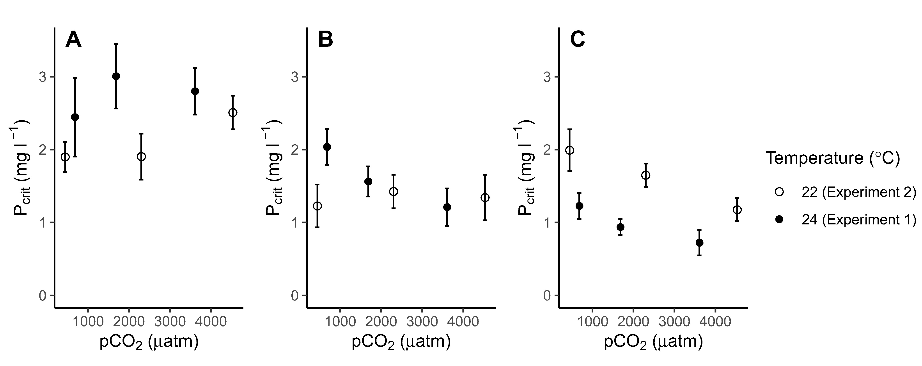

Chapter 2 Results: Critical Oxygen Level
Embryos
2 days-post-hatch
5 days-post-hatch
*Lower P_{crit} means less sensitive to hypoxia
*
*
*
Embryo P_{crit} is not affected by acidification
Surprisingly, larval P_{crit} decreases with acidification
Possible survivor effect – more sensitive ones died at hatching?
Notes:
Explain letters
Only Exp 2 (22C) were affected – maybe because the high CO2 level is higher in that experiment, maybe a threshold between 3600 and 4200
The method used to acidify the treatments in
pH
pCO₂ (µatm)
Temperature (°C)
Amb
Mod
High
Amb
Mod
High
Target levels
8.1
7.5
7.2
450
2000
4000
24 (Exp. 1),
22 (Exp. 2)
Exp. 1
7.94
7.41
7.13
680.0
1683.0
3609.1
23.8
Exp. 2
8.08
7.39
7.09
441.7
2299.2
4530.9
22.3

Slide 27
Ch. 1 and 2 Conclusions
Embryos are more sensitive than larvae
Embryo metabolism increases at highest CO₂ level
Temperature-dependent response
P_{crit} decreases at high CO₂ after hatching – possible advantage for dealing with both stressors
Refutes hypothesis from Chapter 1
Alt. explanation: CO₂ x Oxygen interaction suggests hypoxia impairs embryos’ ability to expend energy regulating pH

Slide 28
Objectives
Chapter 1: Measure metabolic effects of CO₂, temperature, and oxygen treatments
Chapter 2: Does acidification alter metabolic response to progressive, acute hypoxia?
Chapter 3: Identify mechanism of pH regulation in early life stages across CO₂ and temperature levels
Chapter 4: Attribute early life hypoxia responses to energetic mechanisms using a Dynamic Energy Budget
Notes:
-My third chapter I looked at a mechanism of pH regulation to get at the mechanisms that may help early life stages be largely tolerant of high CO2 and low pH

Slide 29

Ocean Acidification & Fish
CO₂
↓pH
H⁺ excreted from gills
Strong regulation
Buffers
in blood

Slide 30
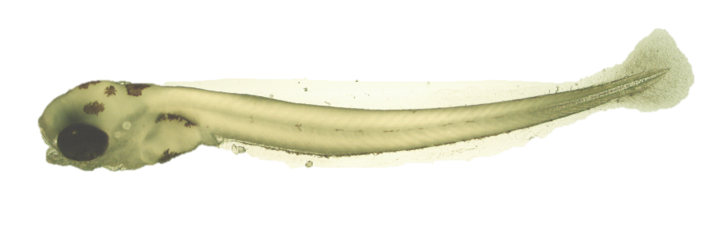
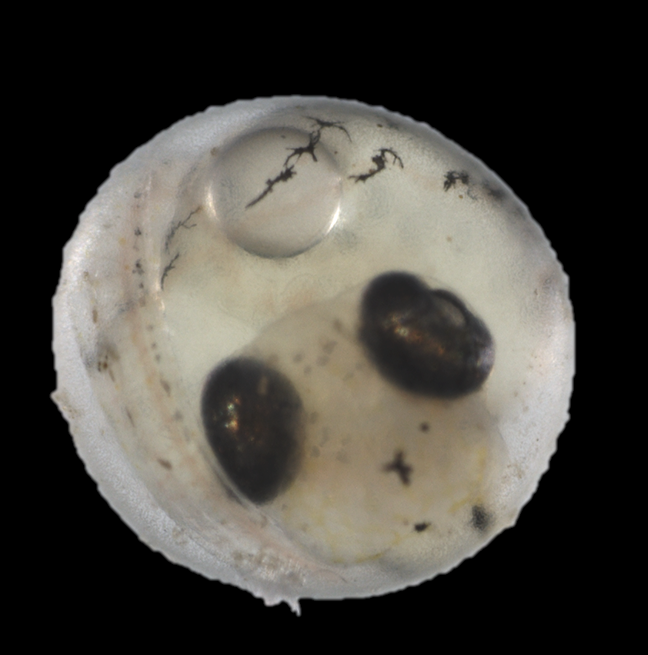
Ocean Acidification & Fish
CO₂
↓pH
Cellular H⁺ removal
Greater sensitivity?
No gills or incomplete

Slide 31
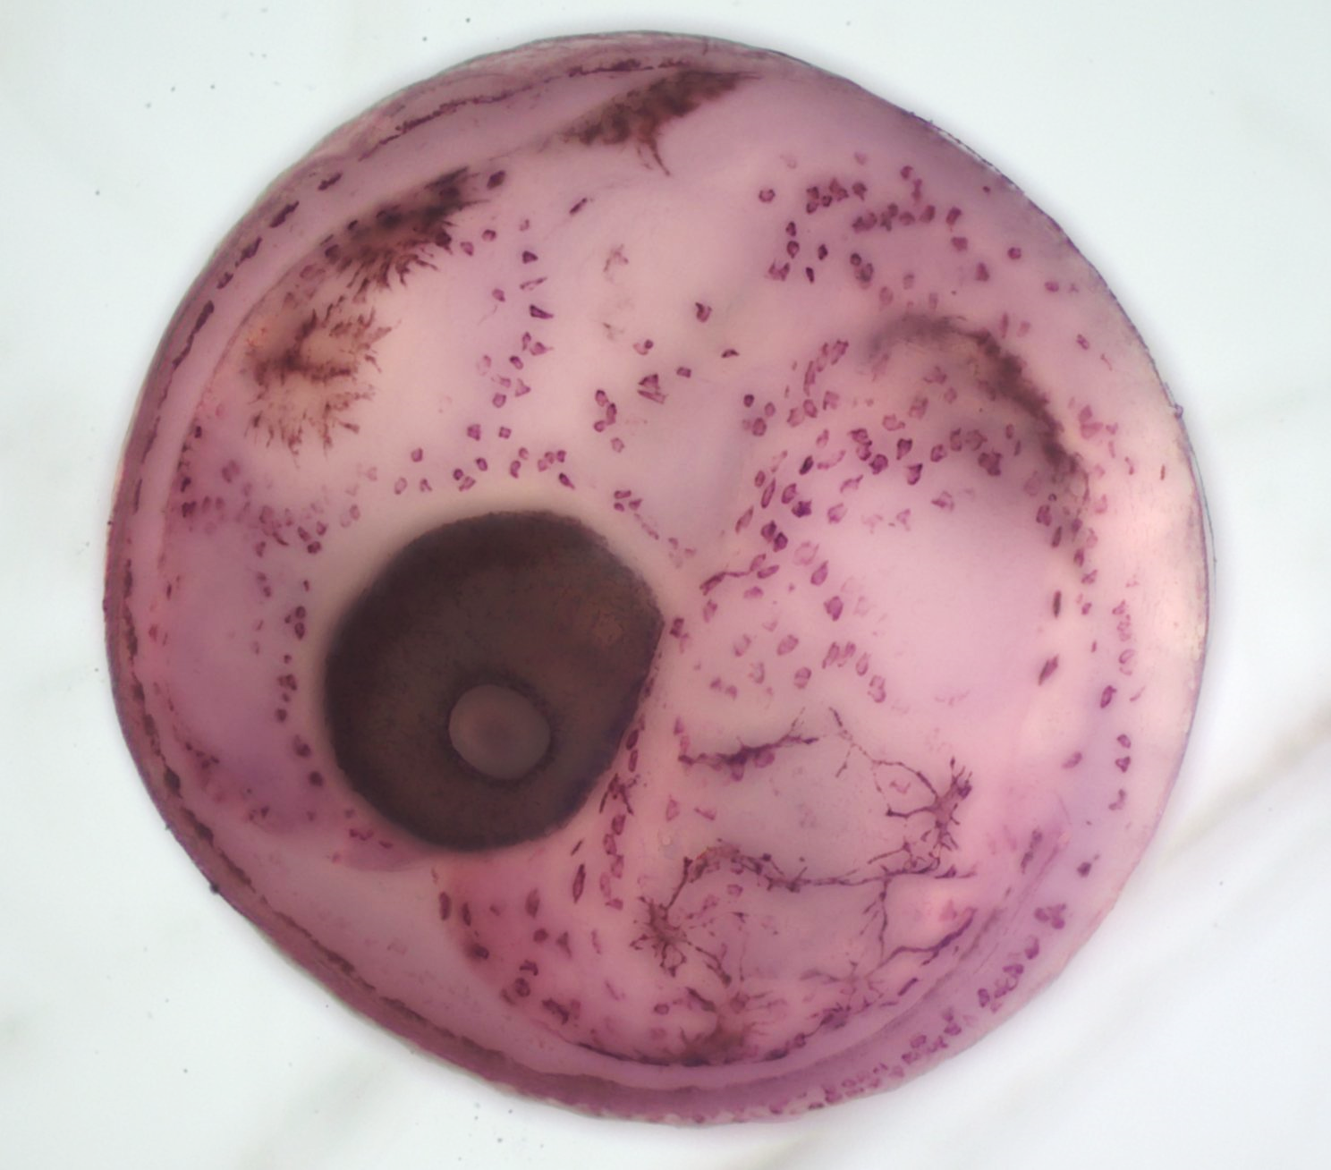
Chapter 3: Ionoregulatory responses to seawater acidification and temperature
What is an ionocyte?
Atlantic silverside embryo

Slide 32
Chapter 3: Ionoregulatory responses to seawater acidification and temperature
Ionocytes (purple)
Pigment
What is an ionocyte?
Cells that use energy to transport ions and maintain internal conditions (salt and pH)
Ionocytes on yolk sac
Eye
Pigment and ionocytes
Atlantic silverside embryo
Notes:
-Ionocytes are also called chloride cells because they transport chloride ions for internal salinity regulation, but they do more than that

Slide 33
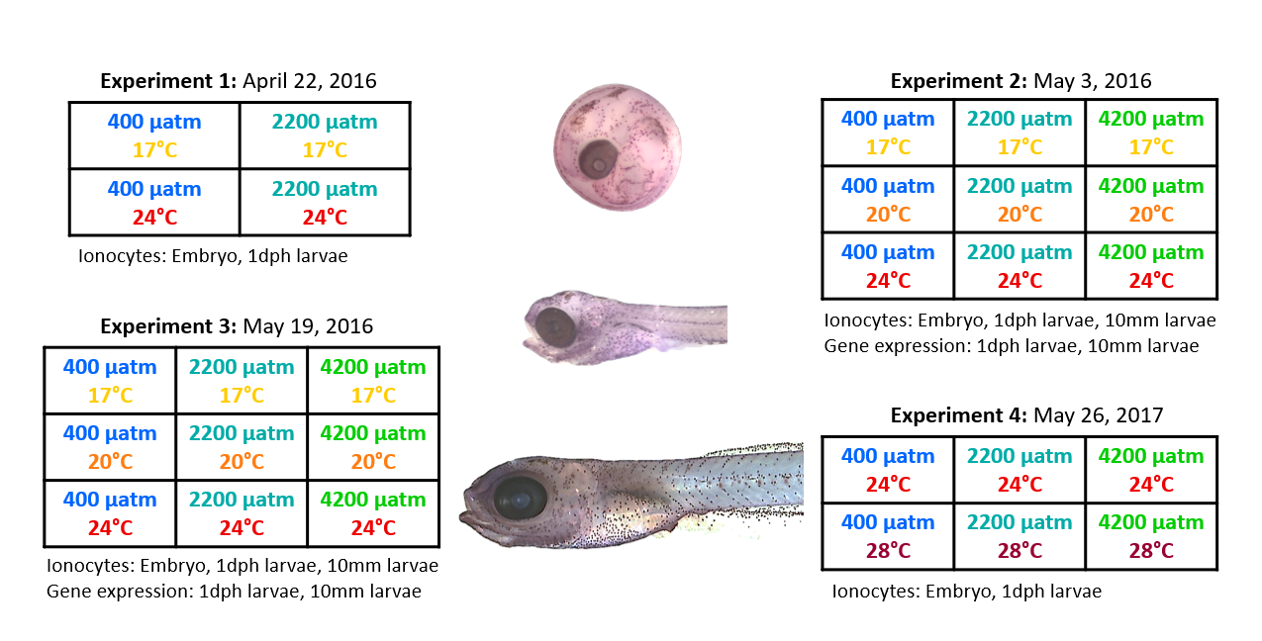
Experimental Design
Four temperature treatments: 17, 20, 24, 28°C
Three CO₂ treatments: 400, 2200, and 4200 µatm
Embryos and hatchlings: same individuals from respirometry in Ch. 1
Embryos 1 day before hatch
Newly hatched larvae (hatchlings)
Larvae that are ~10 mm in length
Notes:
Ionocytes are...
They occur on the skin while the gills are still developing then just in the gills. They use various enzymes to transport ions with or against concentration gradients, which often uses energy.
I stained these using immunohistochemistry, with an antibody that binds to the enzyme Na/K ATPase, and then count the abundance of cells per unit area.

Slide 34
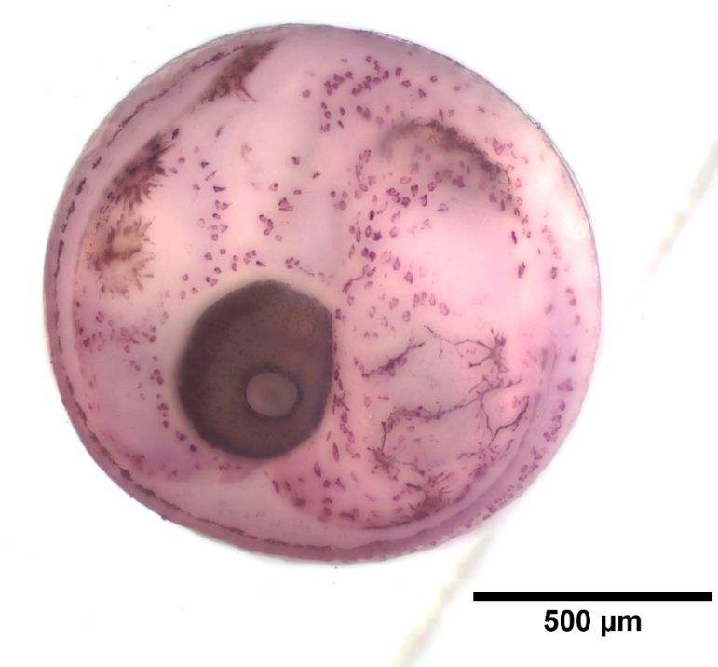
Ionocyte density
Density = # ionocytes/area
Higher density suggests greater capacity for pH regulation
Embryos: Analyzed yolk sac separately
Notes:
But also more energy being used on ph reg
-Why did we look at yolk separately?

Slide 35
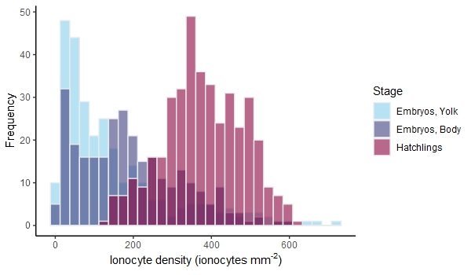
Chapter 3 Results: Density increases after hatching
Most embryos have low ionocyte density, but a few have very high
After hatching, ionocyte density doubles and is more symmetrically distributed

Slide 36
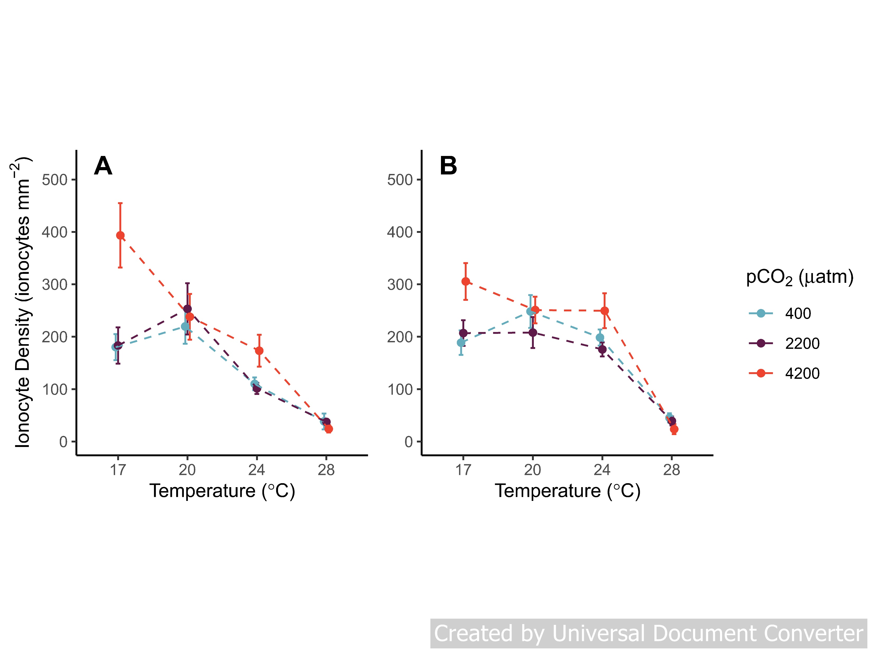
Chapter 3 Results: CO₂ and Temperature Interaction
Yolk Sac
Skin
Ionocyte density decreases as temperature goes up
At 17°C, ionocyte density increases at high CO₂
Stronger effect in yolk sac

Slide 37
Chapter 3 Results: CO₂ and Temperature Interaction
Similar to this type of interaction:
Yolk Sac
Skin
Ionocyte density decreases as temperature goes up
At 17°C, ionocyte density increases at high CO₂
Stronger effect in yolk sac
Control S1 S2 S1 + S2
Notes:
Once again, we saw this type of interaction: where at some temperatures CO2 had an effect and at others it didn’t.

Slide 38
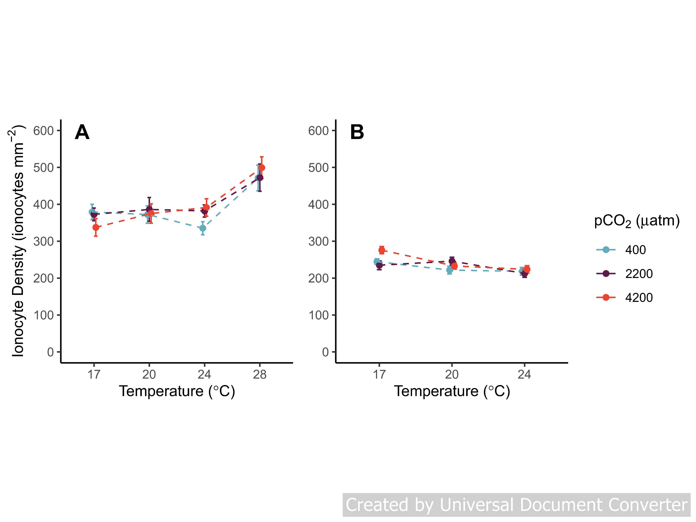
Chapter 3 Results: Larval ionocyte density
Hatchlings
10-mm Larvae
Hatchling ionocyte density increases with temperature
At 24°C ionocyte density increases slightly with CO₂
By 10-mm length, no treatment effects and lower overall ionocyte density

Slide 39
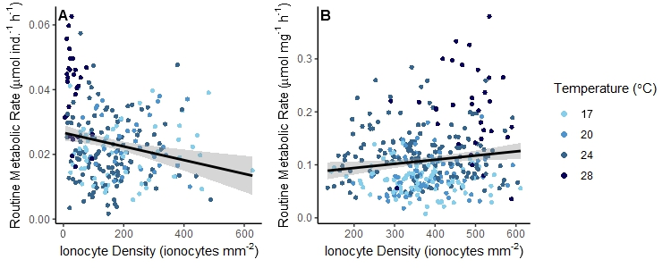
Chapter 3 Results: Does metabolism increase with ionocyte density?
Embryos
Hatchlings
R² = 0.04
R² = 0.02
Relationship switches after hatching
Temperature is strongest factor in both: metabolism and ionocytes

Slide 40
Chapter 3 Conclusions and Next Steps
Temperature influences how well silversides can adjust to high CO₂
Ionocytes proliferate rapidly around time of hatching
May also be a survival effect
Future steps: confirm ionocyte activity
In progress: Gene expression
Future work: Enzyme activity
Notes:
-By looking at the ionocytes we were able to get a better idea of how energy is being used to maintain a constant internal pH despite high CO2 in the water
-Most of these temperatures are ones they already experience for much of the spring and summer
-The lack of CO2 response at higher temperatures may suggest that they will be less capable of tolerating high CO2 later in the season and as water becomes warmer, but it could also suggest that at higher temperatures they may have a tradeoff of lower survival but the ones that survive save energy by having fewer ionocytes.
-We are making the assumption that more ionocytes = more energy spent, but it is possible that they also respond to environmental conditions by changing
The amount of various enzymes they produce (gene exp) or by changing how active those enzymes are
-So more work needs to be done to confirm this assumption
-Maybe since they have fewer ionocytes they are doing more with each ionocyte to maintain acid-base balance

Slide 41
Objectives
Chapter 1: Measure metabolic effects of CO₂, temperature, and oxygen treatments
Chapter 2: Does acidification alter metabolic response to progressive, acute hypoxia?
Chapter 3: Identify mechanism of pH regulation in early life stages across CO₂ and temperature levels
Chapter 4: Attribute early life hypoxia responses to energetic mechanisms using a Dynamic Energy Budget

Slide 42
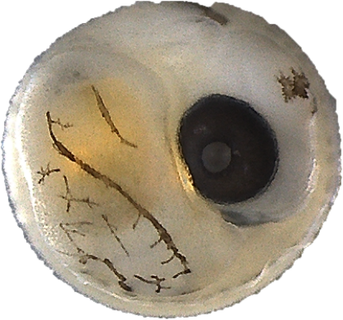
Chapter 4: Attributing hypoxia responses to energetic mechanisms with Dynamic Energy Budget (DEB) model
Objectives
Understand energetic costs and mechanisms of hypoxia, which can interact with other stressors
Use a model that can connect to population level

Slide 43
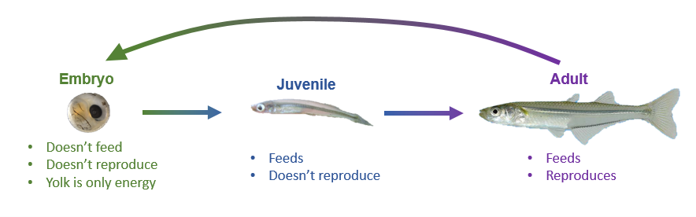
Dynamic Energy Budget (DEB) model
Life stage specific energy sources and costs

Slide 44

DEBkiss A simplified type of DEB model
Somatic maintenance
Growth
Somatic branch (κ)
Feeding
Assimilation
Reproductive
branch (1 – κ)
Egg production
Maturity maintenance
Adapted from T. Jager (2018)
Notes:
-DEBkiss uses size thresholds to turn on or off different parts of the energy budget by life stage
-E.g. when size at puberty is reached, energy begins to be allocated to egg production

Slide 45
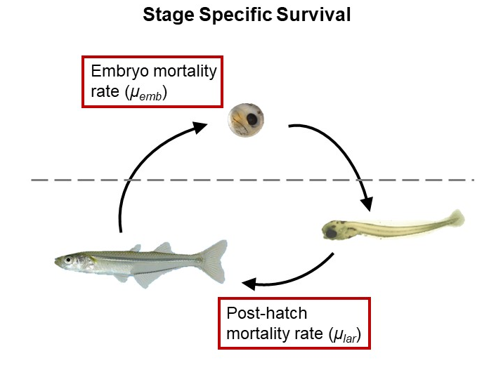
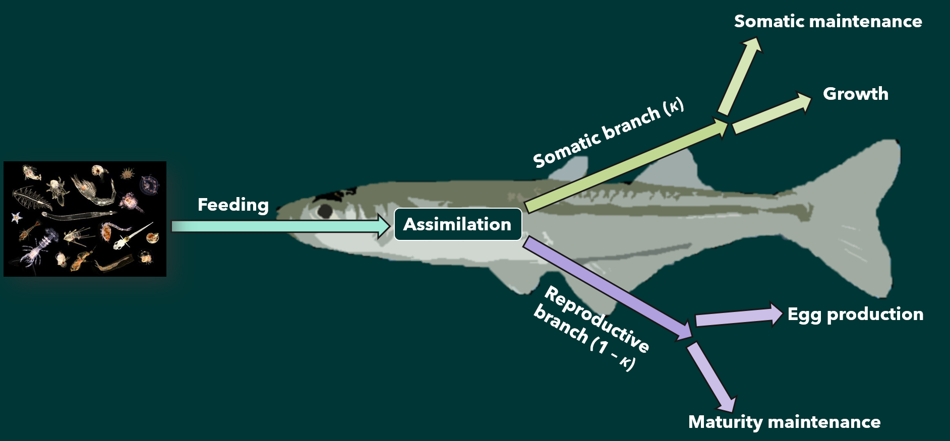
DEBkiss A simplified type of DEB model
Stage-Specific Survival:
Embryo Mortality Rate
Post-Hatch Mortality Rate
Notes:
-We added survival to the model, with embryos having a higher mortality parameter than post-hatching fish

Slide 46
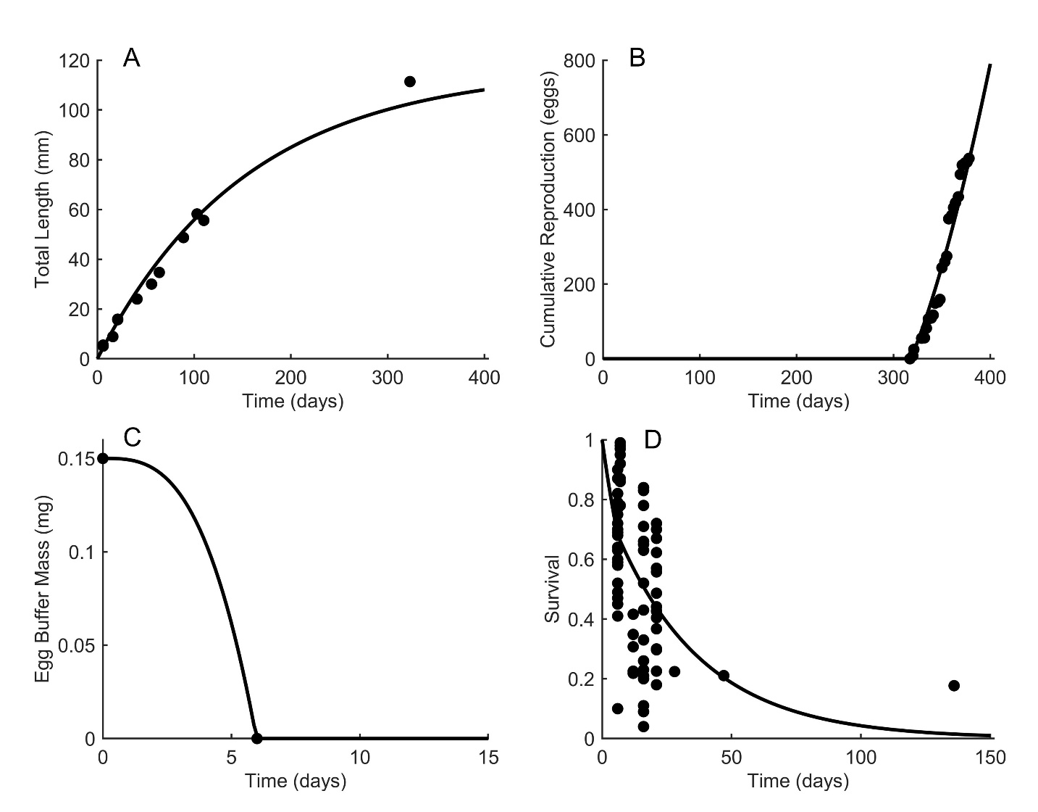
First step: estimate parameters using four types of data:
Total length
Reproduction
Egg buffer mass
Survival
Notes:
-First we estimate the parameters for the model using data from fish reared in fully oxygenated water
-The dots represent the data points we have from experiments that have been published
-The lines are the predicted values of these same variables
-The model tries out different parameter values, calculates the predicted lines, and keeps repeating this until the distance between the predicted lines and the actual data is as low as possible

Slide 47
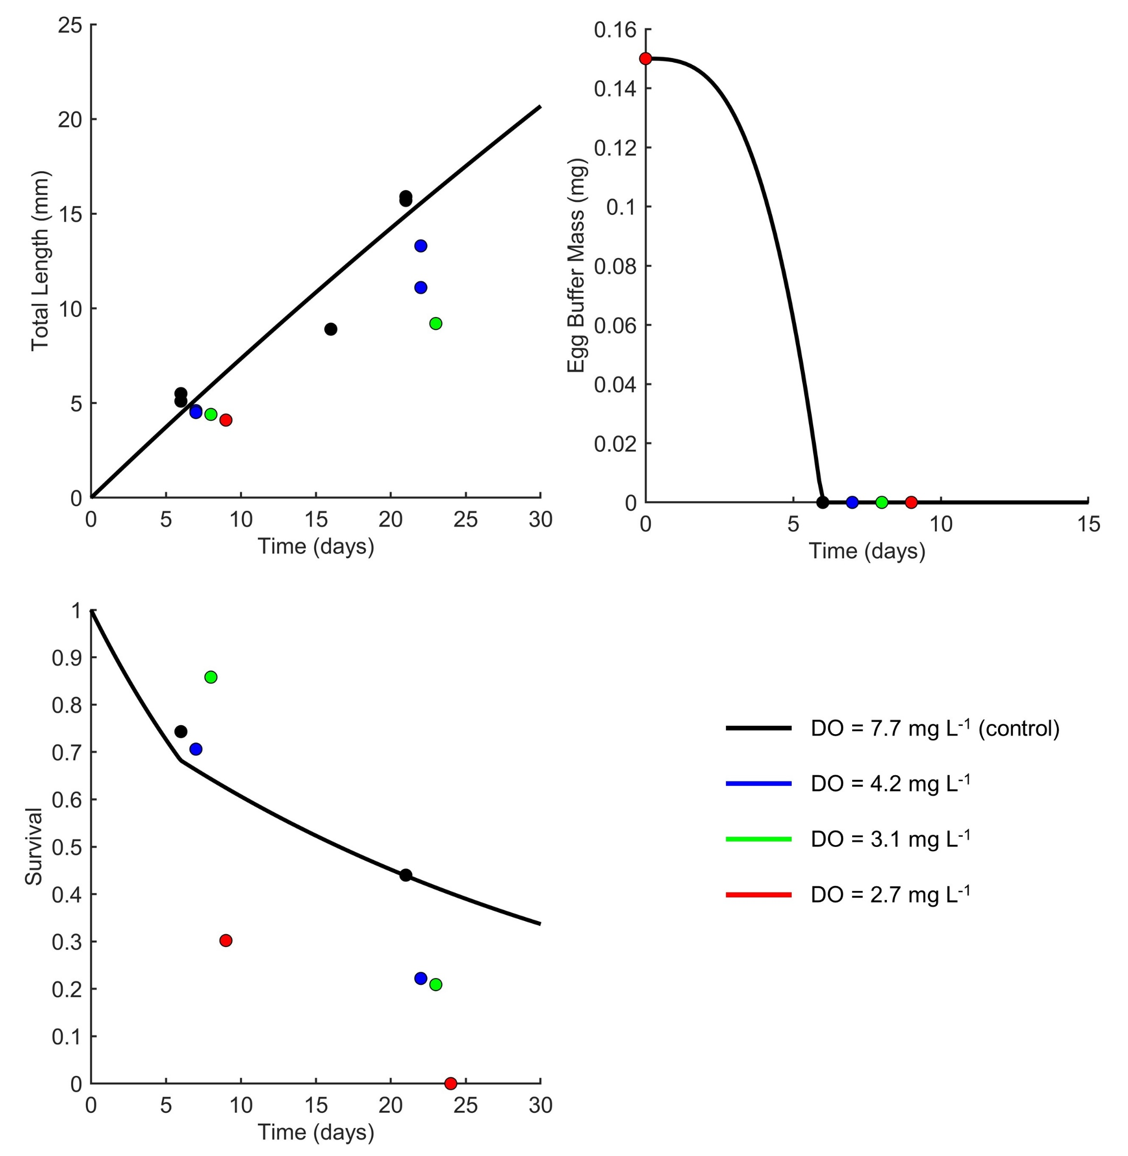
Second step:
What parameters can we change to get the predicted line closer to the observed points?
Use correction factors to make each parameter either increase or decrease with hypoxia
Notes:
-Next we zoomed in on only the first 30 days of their life and added the data from three low oxygen levels
-Because the experiments were only on embryos and larvae, we don’t have reproduction – just total length, egg yolk depletion, and survival over time
-Then we use a correction factor to change each parameter so it either increases or decreases as oxygen gets lower, and try to see what parameters we have to change to get the closest fit to the data

Slide 48
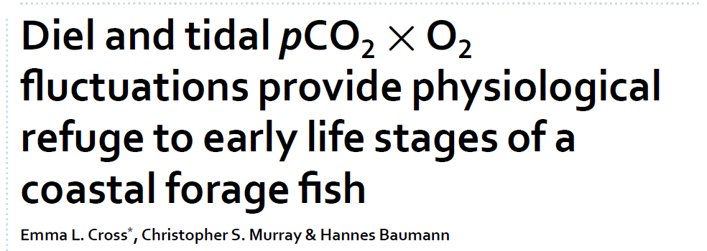
Previous study on hypoxia effects
Rearing silversides in hypoxia causes:
Reduced survival to hatching
Delayed hatching
Smaller size at hatching
Slower larval growth
Reduced larval survival
Cross et al., 2019, Scientific Reports
Notes:
-The data came from this study by Emma Cross, Christopher Murray, and Hannes Baumann
-They used CO2 and oxygen treatments, but we only used the data from the control CO2 level
-Their study showed (these effects)

Slide 49
Previous study on hypoxia effects
Rearing silversides in hypoxia causes:
Reduced survival to hatching
Delayed hatching
Smaller size at hatching
Slower larval growth
Reduced larval survival
Cross et al., 2019, Scientific Reports
All of these suggest changes to energy allocation

Slide 50
Chapter 4 Hypotheses
Stage-Specific Survival:
Embryo Mortality Rate
Somatic maintenance
Conversion efficiency for growth
Assimilation
Post-Hatch Mortality Rate
Notes:
-We hypothesized that changing one or more of these five parameters could enable to model to reproduce the hypoxia effects on growth, egg yolk depletion, and survival
-Assimilation – the rate at which assimilated food is flowing into the energy budget
-Somatic maintenance – the costs of activity and maintaining homeostasis
-Conversion efficiency – for every unit of assimilates that flows towards growth, how much does the body size increase vs how much is wasted on overhead costs
-Mortality rates – what proportion of embryos and larvae die for every unit of time, or what is the risk of dying
-Applied a correction factor to each parameter and combination of these parameters, estimated a parameter controlling the shape of the correction factor, and used AIC to tell us which version of the model provided the best fit

Slide 51
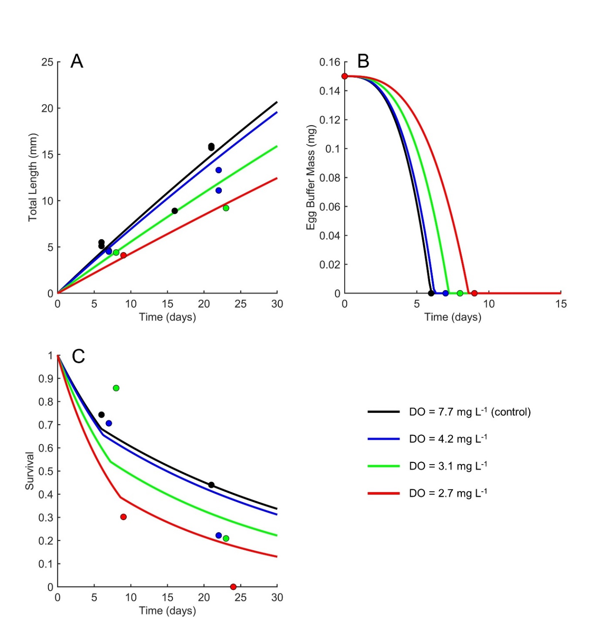
Chapter 4 Results
Best fit adjusts these parameters with hypoxia:
Conversion efficiency of assimilates to growth
Pre- and post-hatch mortality
Conversion efficiency influences total length, hatch timing, and survival
Notes:
-This means that the most likely reason for the observed changes in growth, survival, and hatch timing is that more energy is wasted under hypoxic conditions
-This could be because less ATP is produced when anaerobic metabolism is used when there isn’t enough oxygen
-Wasting more energy means that as the yolk gets used up, less of it is going towards growth
-Because the use of the yolk is slower at a smaller body size, it also delays hatching
-Adjusting maintenance for hypoxia did not do a good job of replicating the effects on growth, hatching, and survival
-But assimilation did almost as well as conversion efficiency, and this is because assimilation has very similar role in the energy budget
-It affects the growth rate because it determines the rate at which yolk or food are used up, and yolk depletion influences hatch timing

Slide 52
Calculated parameter values at each oxygen level
 | Calculated parameter values
Oxygen | 7.7 mg L⁻¹ | 4.2 mg L⁻¹ | 3.1 mg L⁻¹ | 2.7 mg L⁻¹
Conversion efficiency | 0.364 | 0.343 | 0.274 | 0.211
Pre-hatch mortality | 0.175 | 0.186 | 0.234 | 0.303
Post-hatch mortality | 0.0807 | 0.0856 | 0.107 | 0.139
Notes:
At lowest DO level, conversion efficiency is 58% of what it was at normoxia,
And mortality rates are 1.73 times higher (or 73% greater)

Slide 53
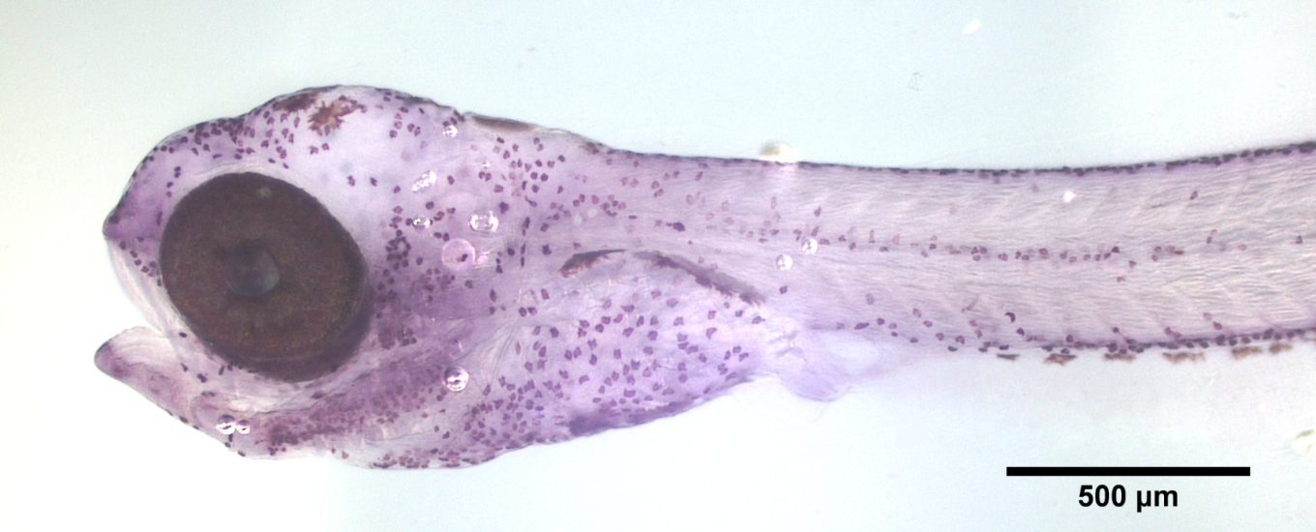
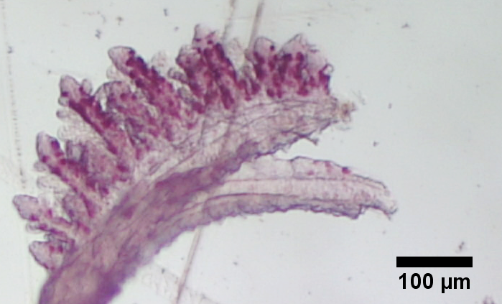
Chapter 4 Conclusions
Reduced conversion efficiency may result from less efficient ATP production by anaerobic metabolism
Implications for development and food needs
Maintenance was not a likely mechanism of hypoxia effects
Slower differentiation of cells → slower ionocyte and gill development?
Notes:
-So what does this actually tell us about how hypoxia affects silversides?
-It tells us that more energy is wasted, possibly because under hypoxia they use more anaerobic metabolism, which has a much lower energy yield than aerobic
-It tells us that the fish may need more food after experiencing temporary hypoxia if they want to compensate for the lower efficiency
-It also has implications for their ability to develop organs and cells, such as ionocytes, which could in turn affect their ability to cope with acidification – and may explain why hypoxia counteracted the increase in metabolism we saw with acidification in Chapter 1.
-There may be some other ways that survival is impacted, such as through toxic byproducts of anaerobic metabolism not being removed sufficiently
Or developmental issues such as deformities or failure to fully develop certain organs by the time the yolk is depleted (which would be indirectly related to conversion efficiency as well)

Slide 54
Chapter 4 Next Steps
Ocean acidification interaction
Incorporate embryo sensitivity
Apply to population growth
Body size, survival, and reproduction can be projected for different hypoxia scenarios

Slide 55
Objectives
Chapter 1: Measure metabolic effects of CO₂, temperature, and oxygen treatments
Chapter 2: Does acidification alter metabolic response to progressive, acute hypoxia?
Chapter 3: Identify mechanism of pH regulation in early life stages across CO₂ and temperature levels
Chapter 4: Attribute early life hypoxia responses to energetic mechanisms using a Dynamic Energy Budget

Slide 56
Conclusions of Dissertation
Stage-specific sensitivity to interacting stressors
Embryos are more sensitive than larvae
Control S1 S2 S1 + S2
Notes:
-Saw most of the negative effects of acidification at the embryo stage – hatching may be an important bottleneck

Slide 57
Conclusions of Dissertation
Implications for species resilience to multiple stressors
Variability across experiments suggests some are tolerant
Survivors may make energetic tradeoffs
Growth,
Reproduction
Ion exchange,
Metabolism
Notes:
-A key to this is likely the fact that they live in a highly variable environment where they periodically experience extreme conditions and have survived thus far
-Genetic variability seems to allow enough to survive that they can produce future generations

Slide 58
Conclusions of Dissertation
Implications for species resilience
Variability across experiments suggests some are tolerant
Survivors may make energetic tradeoffs
Growth,
Reproduction
Ion exchange,
Metabolism
Notes:
-There may still be energetic tradeoffs – if they are spending more energy on maintaining homeostasis, or if the less-efficient anaerobic metabolism must be used more often, there is less energy left for growth
-Looking at the underlying mechanisms helped us understand what the fish are doing to compensate and sometimes allow them to survive and grow well while experiencing stressors

Slide 59
Future Directions
Food consumption
Identify locations of greatly intensifying stressors
Competitive advantage for silversides?
Slower growth → greater risk of predation
Ecosystem level implications – food for higher trophic levels
Notes:
-Look at their food consumption while also measuring things like ionocyte density or metabolism, to see if they consume additional food to compensate for chronic or temporary stressor exposure
-Look at these results in the context of ecosystem and observed conditions in actual bodies of water

Slide 60




Acknowledgements
Committee
Janet Nye (advisor)
Bob Cerrato
Mike Frisk
Roger Nisbet
Amy Maas
Collaborators
Baumann Lab at UConn: Hannes Baumann, Chris Murray, Jake Snyder, Emma Cross
Stony Brook: Maya Peña-Lobel, Nolwenn Dheilly, Megan Hahn, Nils Volkenborn, Steve Abrams, Tom Wilson, and Matt Sclafani
Students who have helped with respirometry and ionocyte analysis: Jake Labriola, Samantha Murphy, Jason Chan, Nicole Margolis, Delphine Mossman, Jeffrey Casey, Yuchen Zhang, Amanda Ackermann

Slide 61






Acknowledgements
The Nye Lab
Janet Nye
Lis Henderson
Adelle Molina
Cecilia O’Leary
Haikun Xu
Emily Markowitz
Tyler Menz
Sarah Weisberg
Baoshan Chen
Kurt Heim
Rich Mahoney
Kelsey Roberts
Carolina Chong-Montenegro
Laura Gruenberg
Sarah Roberts
Ileana Fenwick
Brandon Beltz
Sally Carson Dowd
Camryn Blawas
Jaelyn Leslie
Babka Weisberg-Powers

Slide 62






Acknowledgements

Slide 63






Acknowledgements

Slide 64




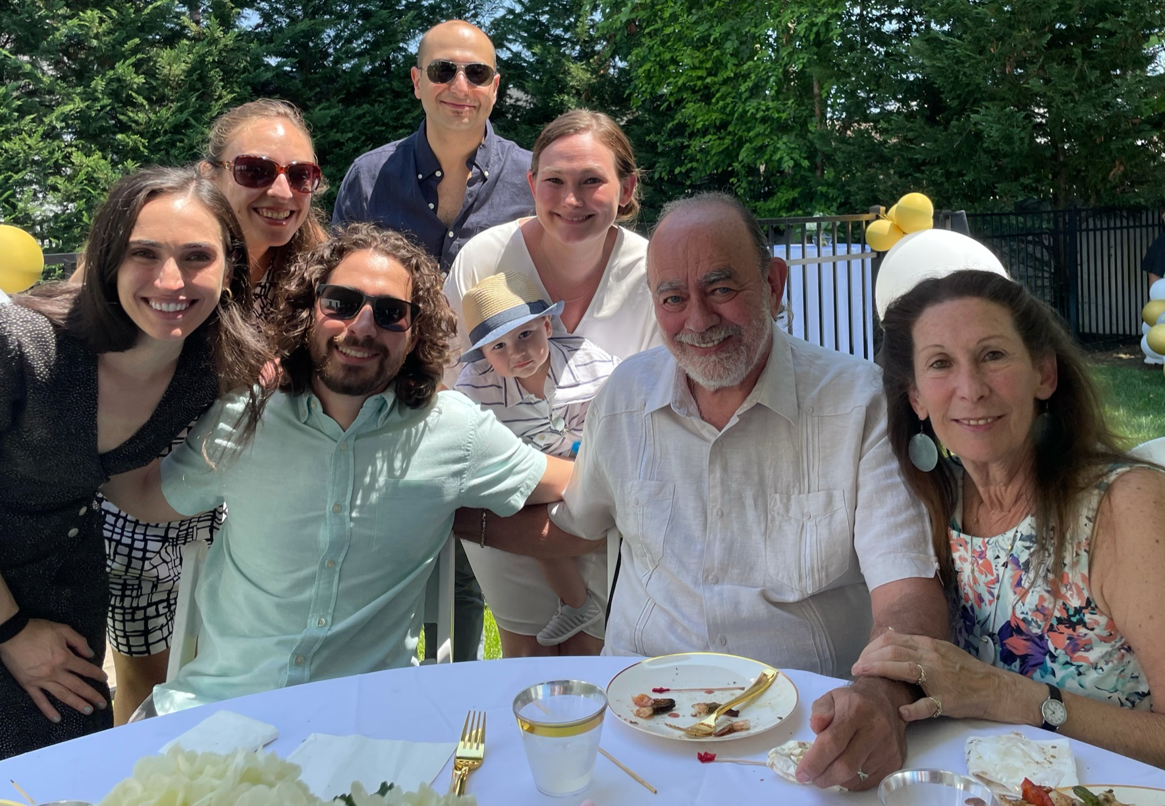



Acknowledgements

Slide 65
Questions?

Slide 66
Bonus slides

Slide 67
Ch. 1 Experimental Design
Experiment | Fertilization Date |  | P_{CO2} (μatm) | Temperature (°C) | P_{O2} (kPa) | Stage
1 |  | 4/22/2016 | 400, 2200 | 17, 24 | 21-23 | E, L
2 |  | 5/3/2016 | 400, 2200, 4200 | 17, 20, 24 | 21-23 | L
3 |  | 5/19/2016 | 400, 2200, 4200 | 17, 20, 24 | 21-23 | E, L
4 |  | 5/26/2017 | 400, 2200, 4200 | 24, 28 | 21-23 | E, L
5 |  | 5/9/2017 | 400, 2200, 4200 | 24 | 7.5, 12.0, 23.0 | E, L*
6 |  | 6/9/2017 | 400, 2200, 4200 | 24 | 9.0, 12.0, 23.0 | E, L
*In Experiment 5, respirometry was only done on larvae from the 23.0 and 12.0 kPa P_{O2} treatments due to low hypoxic hatch survival.
Notes:
Ionocytes are...
They occur on the skin while the gills are still developing then just in the gills. They use various enzymes to transport ions with or against concentration gradients, which often uses energy.
I stained these using immunohistochemistry, with an antibody that binds to the enzyme Na/K ATPase, and then count the abundance of cells per unit area.

Slide 68
Ch. 3 Experimental Design
Notes:
Ionocytes are...
They occur on the skin while the gills are still developing then just in the gills. They use various enzymes to transport ions with or against concentration gradients, which often uses energy.
I stained these using immunohistochemistry, with an antibody that binds to the enzyme Na/K ATPase, and then count the abundance of cells per unit area.

